Slide 1

Housing AI: Style Guide

Slide 2

Table of Contents
Introduction ... 3
Logotype ... 4
Typography ... 5
Colors ...8
Icons …10
Don'ts … 11
Examples … 14
Additional Information … 15

Slide 3
Introduction
In order to make sure that consistency and quality continues to be synonymous with our brand, it is crucial that those who wish to replicate our website abide by these guidelines.
For detailed instructions on the application of all brand assets such as wordmark, symbol, logo types, color and typography please refer to our main website.
Any brand and identity related questions(e.g. regarding logotype or fonts) can be directed to brand.housingai.com. Questions regarding "Housing AI" design may be directed to corporate-ui@HousingAI.com

Slide 4

Logotype
As the main identifier for Housing AI, the Housing AI symbol is placed on the welcome page of our website and app.

Slide 5
Typography
Typographic Settings
1. Headline: Congenial
a. Font size: 24px and up
b. Text: Upper and Lowercase
c. Letter Spacing: 0
2. Subheadline: Congenial
Font size: 18px and lower
Text: Upper/Lowercase
Letter spacing: 0
3. Bodycopy and labels: Congenial UltraLight
Font size: 14px and lower
b. Upper/Lowercase
Letter Spacing: 0
For headers and titles, Congenial is used. It is available as Bold (first hand choice for main headlines), Semibold(for moderate headlines) and Regular (for longer headlines or sub-headlines).
Subheadlines also use the same format of Congenial
Bodycopy and labels also Congenial UltraLight. Also available in Italic and bold italic

Slide 6
Typography cont.
Headlines: Congenial – Bold
Headlines: Congenial – Semibold
Headlines – Congenial - Regular
Subheadlines: Congenial – Bold
Subheadlines: Congenial – Semibold
Subheadlines Congenial - Regular
Bodycopy and labels: Congenial - UltraLight

Slide 7
Typography cont.
Replacement Fonts
If any of the primary fonts are not available, it is instructed that you use:
Arial – Headlines and Subheadlines
Times New Roman – labels and bodycopy

Slide 8
Colors
The Housing AI color palette does not exclusively rely on the use of the logo colors or colors like it. The color palette mostly consists of colors with cool undertones of green and blue. The background colors will consist of mostly whites and grays.
Logo Colors:
#ffffff, RGB: 0,0,1White
#000000, RGB: 0,0,0, Black
#45D4D4,RGB: 69,212,212, Sea Green
Primary Colors:
#ffffff, RGB: 0,0,1White
#000000, RGB: 0,0,0, Black
#45D4D4,RGB: 69,212,212, Sea Green

Slide 9
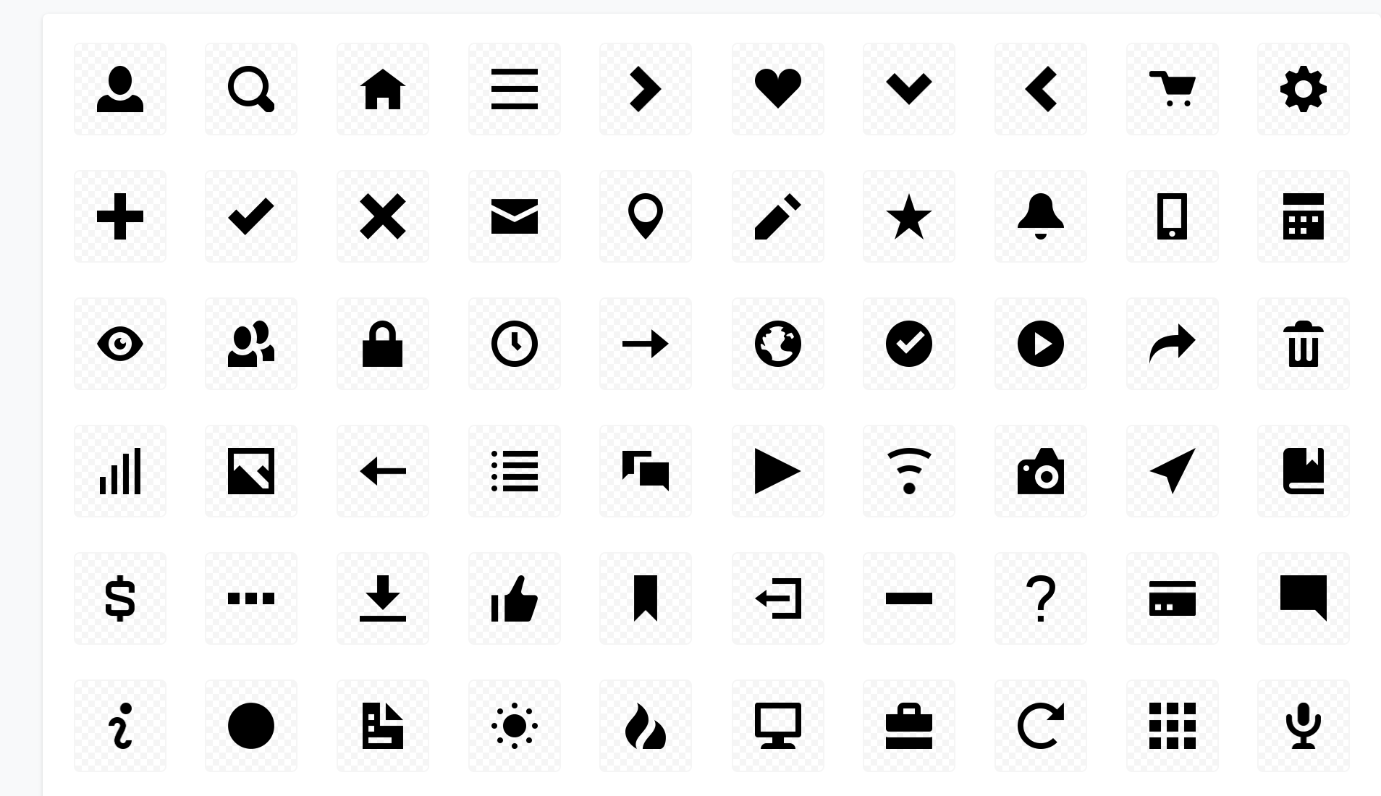
Icons
The icons that should be used are listed on the right. Any other miscellaneous icons will be located on the Housing AI primary website under development reference.

Slide 10
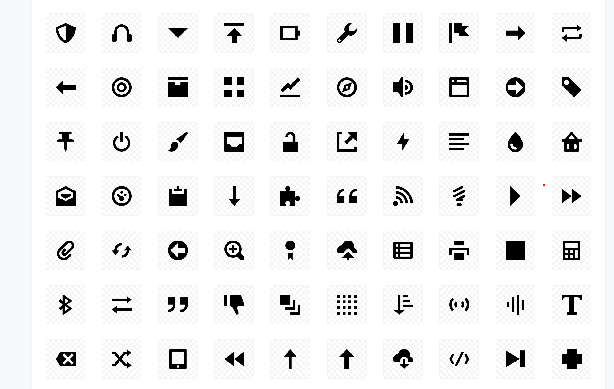
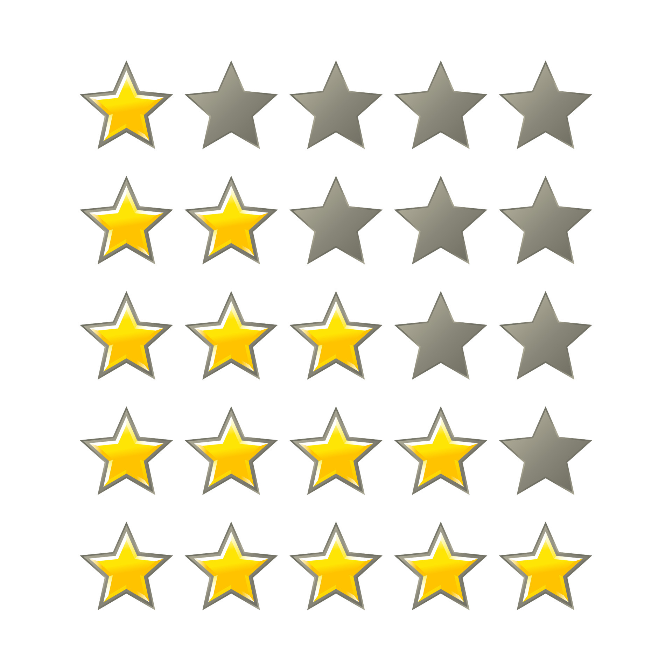
Icons cont.

Slide 11
Don’ts
Do not use unapproved colors or logos.
Do not reproduce any part of the Housing AI logotype in any other color than the original color
Do not use icons for decoration or as logotypes
Do not reinvent app icon templates or change the margins.
Do not use any unapproved icons
Do not try to reinvent the Housing AI logo

Slide 12
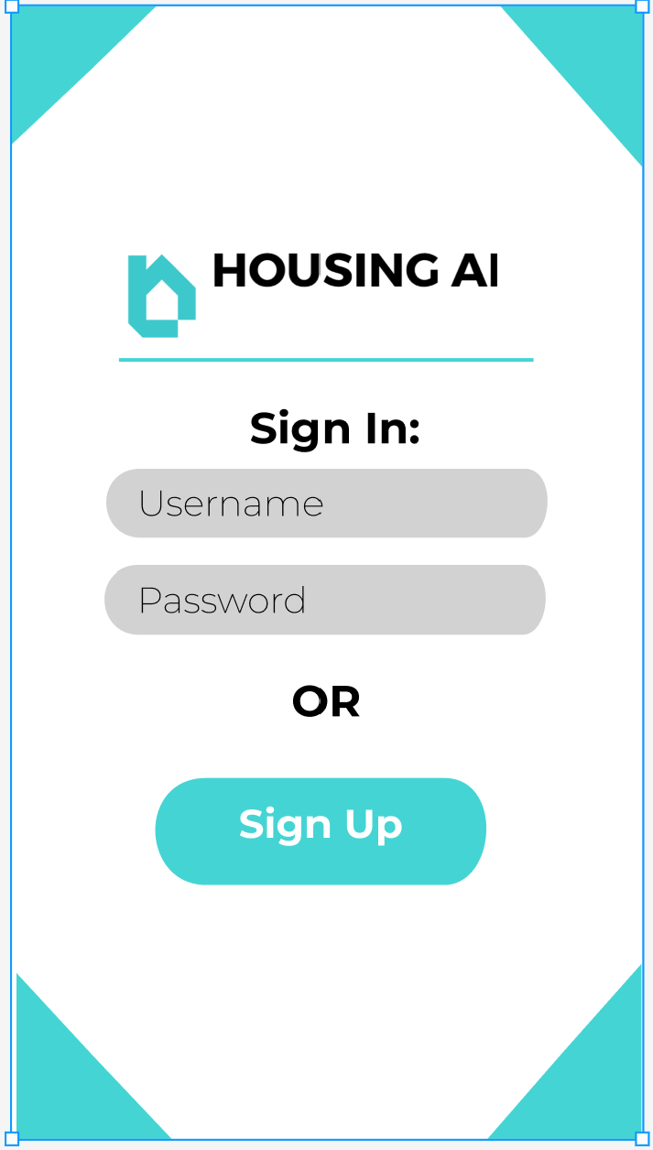
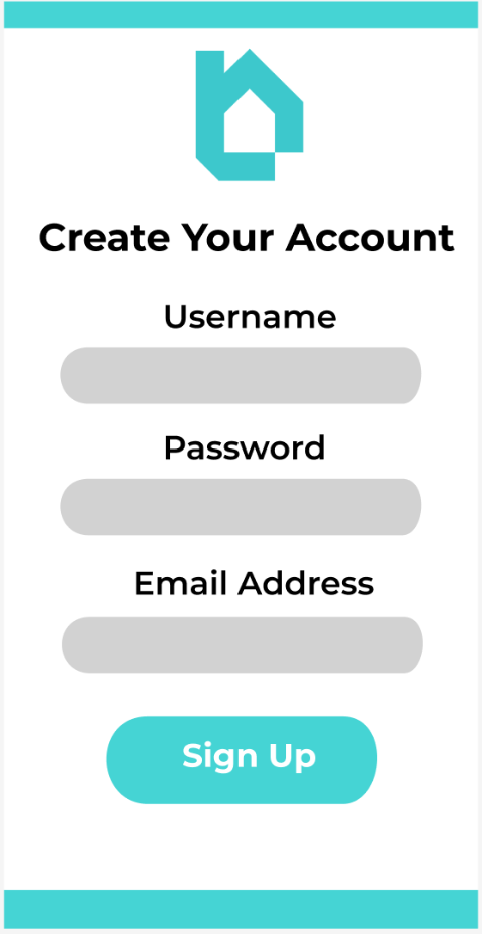
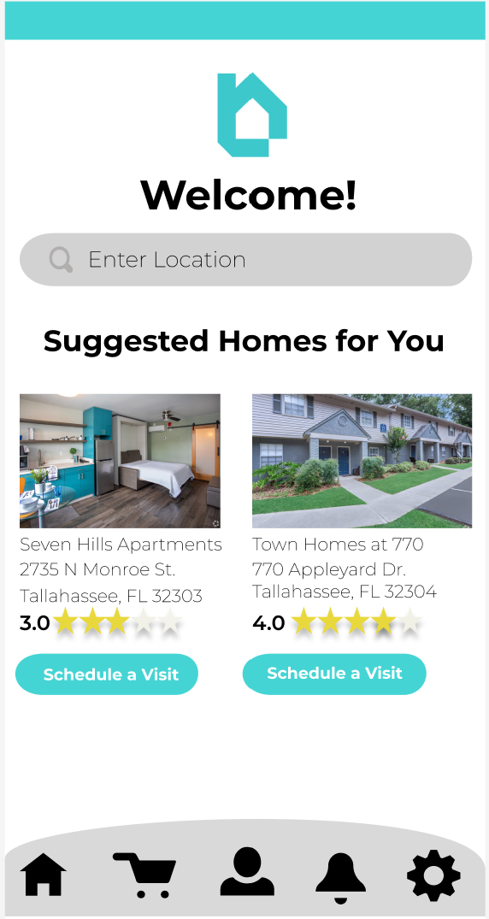
Examples

Slide 13
Additional Information
If you have any questions, comments, or concerns regarding stylistic details, please contact us at:
ApplicationAndDesign@HousingAI.com
Or
Marketing@HousingAI.com

